Slide 1
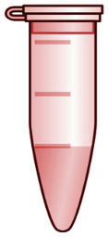













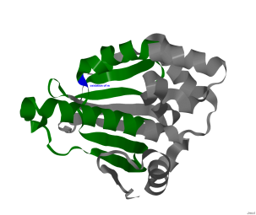
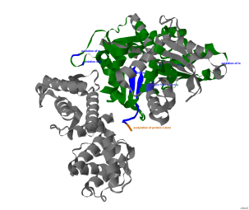
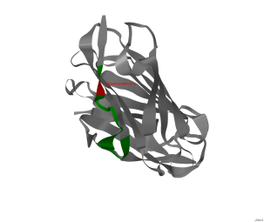
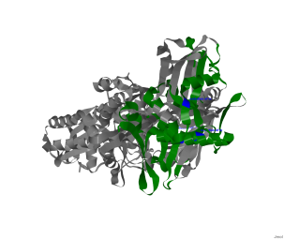
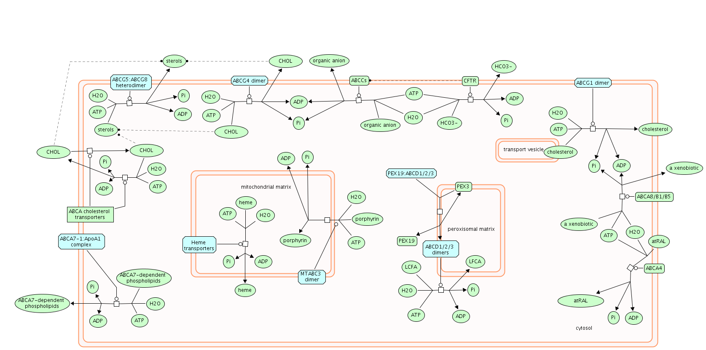



Patient
Control
Protein 1
Identification
Protein 2
Protein 3
Protein 4
Quantification
Patient / Control
Annotation
Data Sharing
Results Annotation
Data Reprocessing
Dissemination
Repositories
External
Resources

